Slide 1

Chandra X-ray Observatory
The 2020 HRC Anomaly
Progress so far and plans for Return to Science
Ralph Kraft on behalf of the HRC Team

Slide 2
The Anomaly
Early on August 24, the HRC suffered from an anomaly of unknown cause, leading to off-nominal voltages on its +/- 15 V bus. The HRC cannot be used for science in this state.
We first attempted a reset of the Side A electronics, which did initially return the voltages to nominal values. However, 11 hours later, the anomaly returned.
Our next option was to swap the HRC’s power configuration to redundant (“Side B”) electronics. This was successfully completed on August 31.
The HRC has now been nominal and stable for more than a month since the Side B Swap. We are enacting a multi-step plan for a staged, slow return to science.

Slide 3
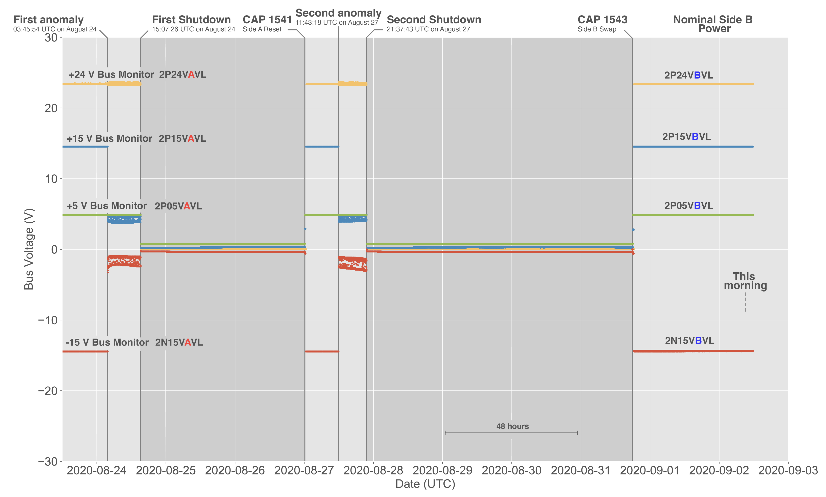

Slide 4
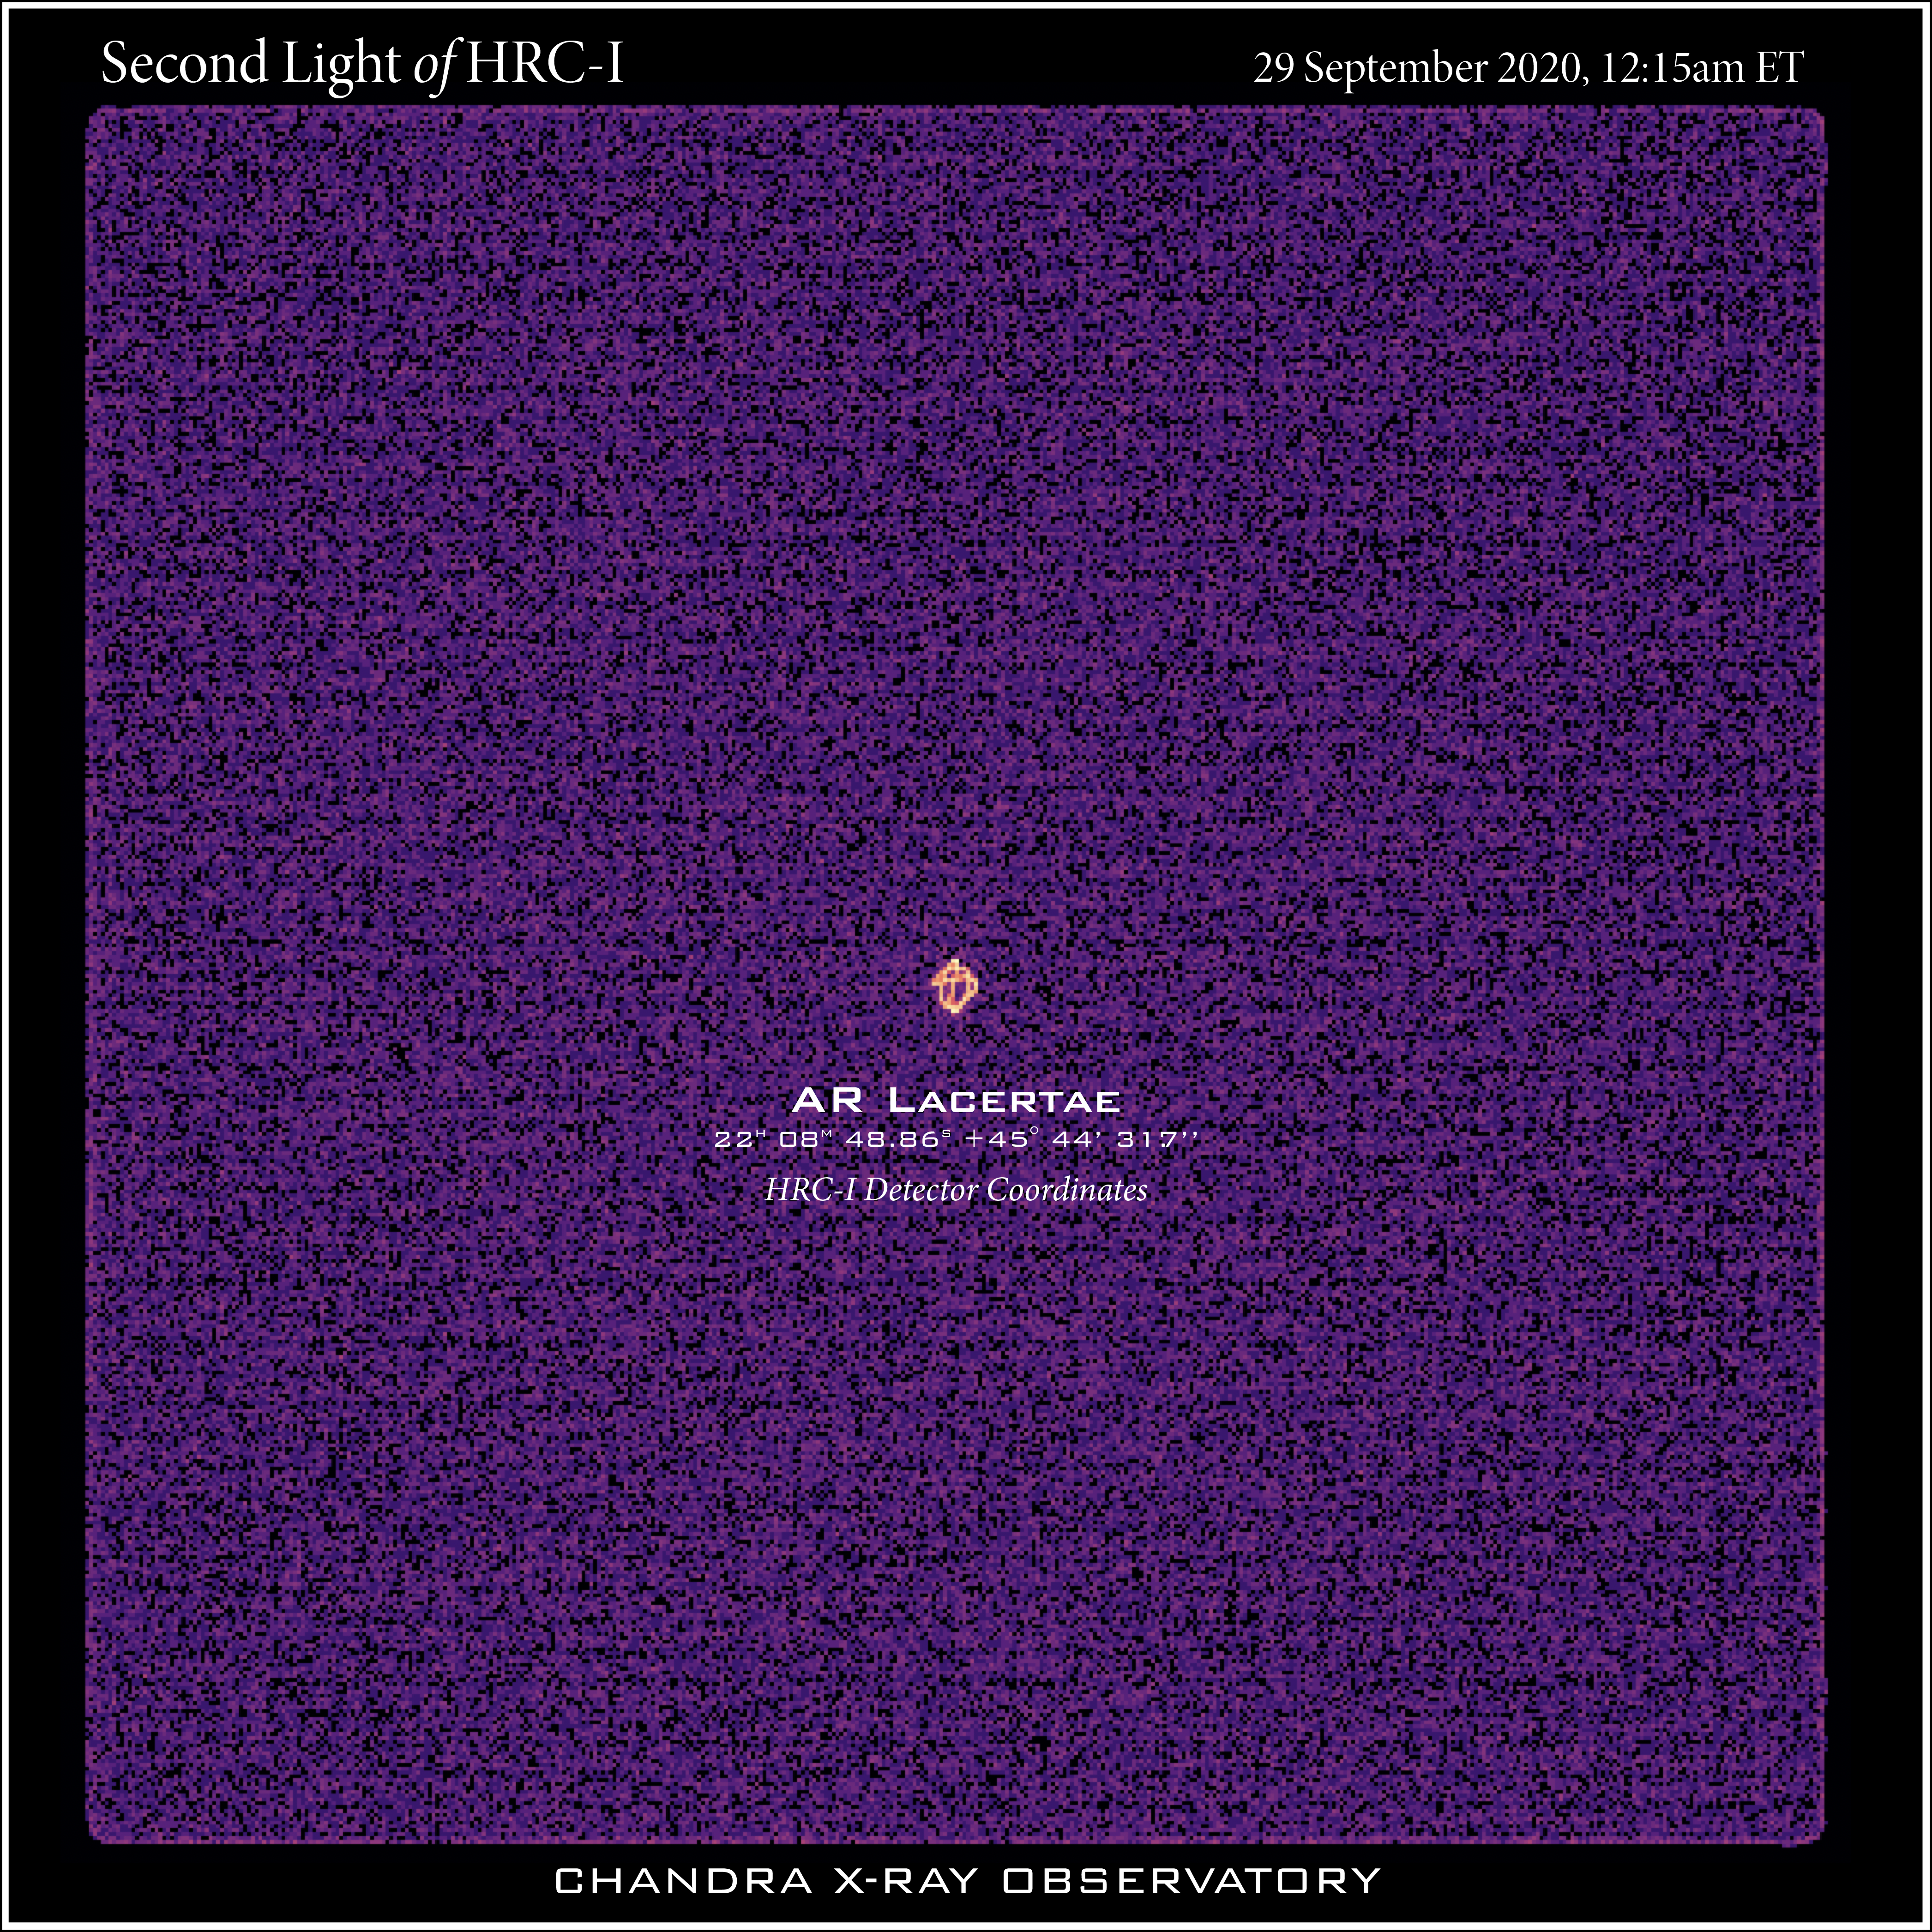
“Second light” following a successful HRC-I Power-up on Sep 29

